Slide 1
Sunshine For Computer System
(A Subsidiary for SAUDI LADA Group of companies)
Corporate Profile
Confidential Year 2010-2011

Slide 2

Introduction – Sunshine For Computer System
Subsidiary of Saudi Lada Group of Companies
Established in 2007
HQ in Riyadh, Saudi Arabia
Class 1 Contractor
Among the fasted growing companies in the Kingdom of Saudi Arabia
Quality Products & Professional Services
Excellent Project Management
Main offices in Medina, Al khobar and many operational offices
Global presences with many technology partners around the globe

Slide 3
Business Focus
Sunshine
Software Products
IT & Telecom
Area of business interest
Telecom
Education
Government
Hospitals
Banking
Information Technology
Education
Networking
WiMax
HMS
Implementation
MIcrowave
OSS/BSS
Project Management
VHF-UHF
Smart Building
Wi-Fi
BMS
Wi-Fi

Slide 4



Our Solutions And Services
One Stop IT & Telecom Shop
Design, Implement & Consultant for Network(LAN,WAN )
System Integration Services
Customized Solution (Product and services)
Full Turn Key Solution and Managed Services
Excellent Support
Excellent Quality Products
R&D Department
Local Repair Center
Global Presence (thru local partners )
Civil – RF – RF Indoor – FO –IT – R&D – O&M

Slide 5
Professional Resources

Slide 6
Product and Services
Offered

Slide 7
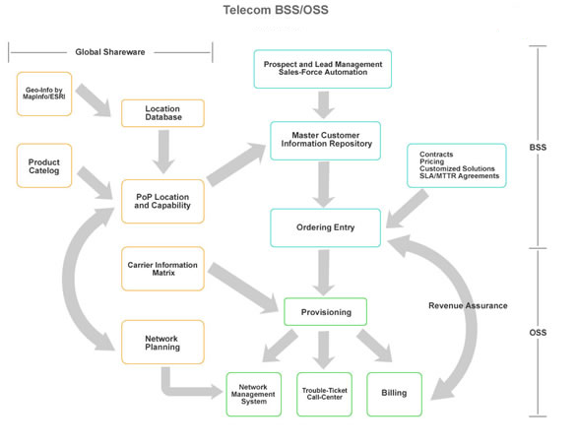
Telecom BSS/OSS
Brief Description:
Unique Features:
  Single platform to check performance for major verticals of telecom business
  Map interface to visualize plan, performance and reality
  Uses historical data to enable top management to take strategic decisions
  Customize business rules/logic to suit local conditions
  Open source programming
  Customized reports
Benefits to Operator:
  Bring in business efficiency and maximize ROI
  Investments and strategy based on past performance/trends; minimize risk
  Understand strength and weakness in business; help select appropriate business model
A Unique and innovative software product which enables operators to develop business strategy after understanding the performance from sales, marketing, distribution, network, usage and other important.

Slide 8
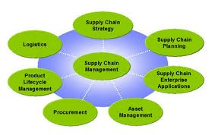
Supply Chain Management
Brief Description:
Unique Features:
  Uses RFID with handhelds to avoid manual intervention; completely automated
  Can be customized to suit local conditions and market
  Indicate Distribution, Balance cards, Sales patterns on Map; view geographical spread
  Track performance of distributor, retailer and FOS
  Route plan for FOS and prioritization
  Customized MIS Reports
Benefits to Operator:
  Ensure efficient SIM/Recharge voucher distribution; significant capex and opex savings
  Timely actions to ensure presence
  Increased efficiency
This is a product specially developed for the mobile industry. Uses state of art RFID for management and tracking SIM cards and recharge vouchers. Integrates with Telecom BSS to produce real-time reports on supply chain management.

Slide 9



Cell-site Asset Management System
Brief Description:
Unique Features:
    State of Art RFID based
    Covers all elements of network
    Flexibility of customization
    Open source programming; reduced costs
    Customized reports
    Integration with existing systems
    Option of further automation by SMS integration
Benefits to Operator:
    Asset tracking and optimizing Capital Expenditure (Capex)
    Reduced downtime
    Reduce Operational Expenditure (Opex)
Asset tracking is a challenge for Telecom Operators. This is due to frequent change/upgrade, vast coverage area, multivendor, multi technology, numerous models and parts.

Slide 10

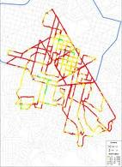
Network Benchmarking
Brief Description:
Unique Features:
  Covers all services and technologies
  Highly experienced manpower used to execute and analyze
  Exhaustive report with analysis and remedies to improve KPIs
  Complete raw data available for future reference
Benefits to Operator:
  Enhanced customer experience
  Understanding strengths and weaknesses
  Provides roadmap for future rollout
  Audit results with network vendor reports
Conduct Network benchmarking to access network quality for all CS and PS services and compare it with competition. This enable operators to get a third party view and customer perception about the network accessibility, integrity and retainability for its services. Benchmarking can be done with competition irrespective of technology (GSM, CDMA, WCDMA).

Slide 11

Network Planning Services
Brief Description:
Unique Features:
  Planning for all elements of voice, data and VAS network; vendor independent design
  Use proper tools and market assumptions
  Experienced manpower with high productivity
  Ensure balance between network design and Capex; reuse existing infrastructure
  Ensure adherence to best practice rules of network planning
  Updated with technology and latest features
Benefits to Operator :
  A realistic network plan
  Vendor independent plan enables operator to swap or have multi vendors; reduce risk
  Work on project basis; reduced manpower overheads
Sunshine is capable of providing Network Planning services for GSM/WCDMA/CDMA/WIMAX network deployment. A set of highly skilled and experienced engineers with a able team leader can ensure that the network plans meet the set criteria of coverage, quality and capacity.

Slide 12
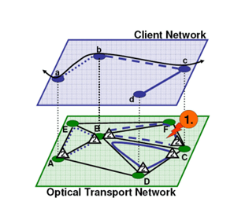
Network Optimization Services
Brief Description:
Unique Features:
  Different models of rendering the services enable to pick and choose
  100% measure performance. Highlight KPIs regularly to management
  Highly responsive and experienced team with high productivity
  Highly experienced sub contractor(s) with worldwide experience
  Updated with technology, tools and latest features
Benefits to operator:
  Increase competitiveness in the market
  Reduce manpower overheads
  Ensure KPIs are met as per regulator/market
Network optimization is a continuous process and need highly skilled people. It has become even more challenging because of the network complexity with entry of new technologies and services. To remain competitive in the market, every operator has to have a quick and efficient network optimization team , (Especially for Fiber & UTP cables)

Slide 13
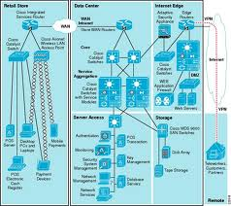
End to End Network Audit Services
Brief Description:
Unique Features:
  Audit Encompasses all interfaces/hardware of network
  Due attention to PS services
  Uses past and current usage to dimension network with headroom for growth
  Detailed report with improvement suggestions
  Highly experienced manpower
Benefits to operator:
  Optimum capex and opex utilization
  Better customer experience
  Network that is ready to take on growth
  Build suitable tariff plans with incurring more capex
The network monitoring can be broadly classified into 2 parts, the core network part and the access network. The interfaces that interconnect these two are highly neglected & deteriorate network experience & revenue and often remain unnoticed. With the increase in data traffic, Packet Switch network has become important. Most of the services in the PS domain are best effort based and need maximum attention.

Slide 14
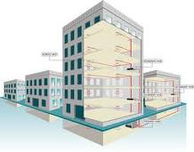
In-Building Coverage Solution
Brief Description:
Unique Features:
  Solutions that meet the requirement of various technologies for collocation, like, GSM900, GSM1800, CDMA, WCDMA, WIMAX and Wi-Fi
  Multi operator solutions for collocation possibility
  Capex reduction/optimization by use of RF Repeater/Micro BTS/Macro BTS based on need
  Detailed design document with link budgets, floor plans, BoQ, etc
Benefits to Operator:
  Superior customer experience and reduced complaints
  Improved network KPIs- Drop call Rate, call success rate, congestion, etc
  Increased revenue
It has also become an hygiene factor to provide in-building coverage in most building. With newer technologies and spectrum allocations being in the higher frequency band, it has become more challenging for operators to provide good in-building coverage.

Slide 15


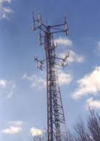
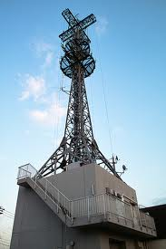
Civil Department
Products
COW/DOW/RDV
RDS
Shelters
Air Craft Warning Lights
Towers & Monopoles
Pre-Cast Foundation & Solutions
Services
Fixed/Mobile Sites/exchanges – Complete civil work
Site Acquisition
Survey & Design with Government permission
Foundation works
Tower Erection
Tower Analysis
Consultancy Services
Fiber Optic & UTP Civil Works
Implementation of COW/DOW/RDV & RDS
Operations & Maintenance

Slide 16
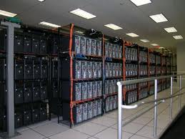
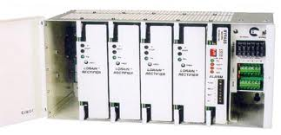

Electromechanical Department
Products
Inventers
Rectifiers + Cabinets
Batteries
Generator
Accessories
UPS
Services
Electrical Design study
  Existing electrical network Site Survey
Electrical Design Solution…
  DATA CENTERS
  TELEPHONE EXCHANGES
  COMMERCIAL & TECHNICAL BUILDINGS
Load Flow Analysis
Implementation
Consultancy
Operations & Maintenance

Slide 17
Value Added Service & Information Technology Department
Value Added Services
USSD call back for International Roamers
Voice SMS
Daily, weekly and monthly SMS, STD, ISD & GPRS packs
Device handlers to add GPRS subs
Mobile Payment
Auto download of customized Java application and integration
SIM card based services - Dual IMSI/Triple IMSI
Location based services
Software Development
Hospital Management System
Education system
Education system
e-learning
GSM Data Audit Toll
Web based Mobile Application
Customized Solutions
Operation & Business Support System
OSS/BSS
Network Management
Performance Monitoring
Provisional & Fulfillment
Revenue Assurance & Fraud Management
Asset Management
Customer Care
Billing
Information and Communication Technologies
Implementation of all the work of low current
IP Telecommunication & VOIP
Broadband Audio Video (IPTV)
Wireless Networking
Central Control & Monitoring
Building Management and security

Slide 18
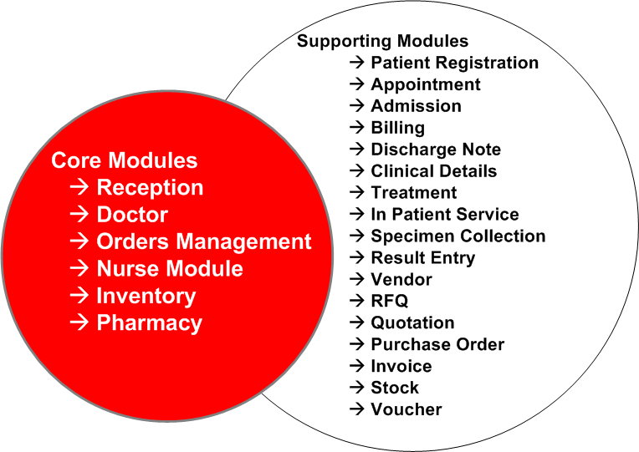
Hospital & Clinics Management (Software product)
Hospital Management System is designed to support all the critical business support functionalities to ensure smooth functioning of Hospitals.
The Product adheres to international standards of Healthcare and supports the state of the art functionalities required to run the business.

Slide 19

Education Business Support System (Software Product)
Online Training
Online Examination System
Integrated with Students, teacher & parent forum
Web based student knowledge assessment Module
Franchisee management for online & classroom training
Online portal for complete business Management of a training institute or education institutions.

Slide 20
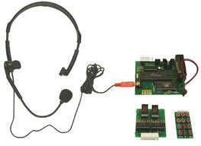
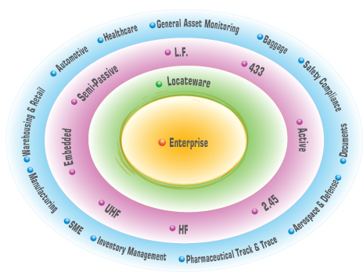
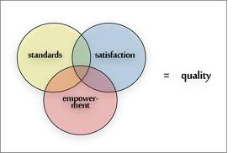
Research & Development Department
Pro-Active Research & Development
Core research activities
  Speech Quality Evaluation
  Speech Recognition
  Quality of Experience in mobile networks
Customized Solutions to meet specific Customer requirements
Complete Spectrum of Information Management
Experienced and certified Team member
Consultancy Services

Slide 21
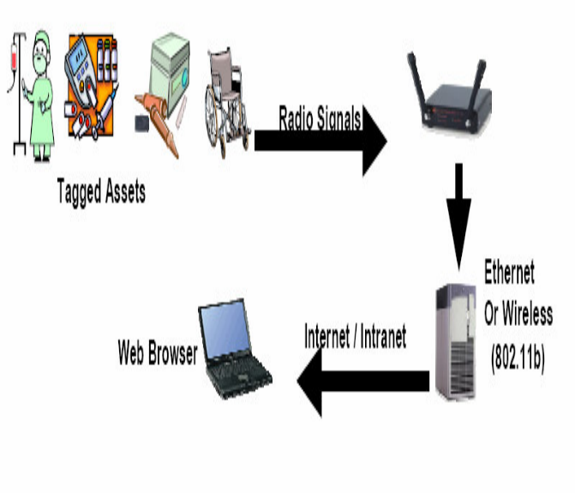

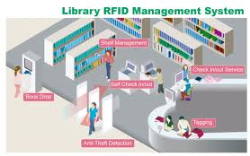
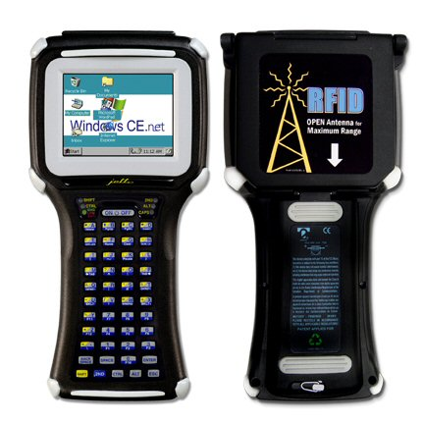
Radio Frequency IDentification
RFID and Barcode based Automation Solutions for various verticals including Logistics, FMCG, Retail, Transportation, Telecom, Education, Healthcare and Hospitality Business.
We offer customized RFID solutions for many business verticals.
  Warehouse Management System
  Enterprise Asset tracking and Management System
  Asset & People tracking system for Hospitals
  Smart Document Management System
  Toll Management System
  Livestock Monitoring
  Jewelry Inventory Solutions
Quality First
21

Slide 22
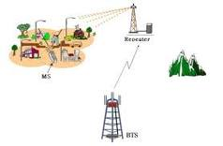
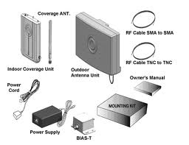
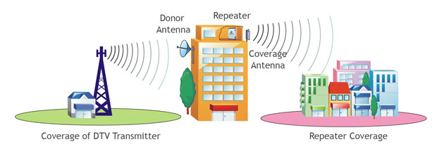
RF Outdoor Department
Products
Filter
RF Antennas
Cell Enhancer
Clean Site Solution
Qvoice(QOS)& Benchmarking
Cell Booster & Repeaters
WiMax
VHF/UHF & TETRA
Services
RF Planning
Optimization
Benchmarking
Drive test
Consultancy services
Site survey
RF Node B Implementation
BSC Implementation
Operations & Maintenance

Slide 23


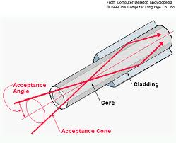
Fiber Optics Department
GPON/GEPON/10GEPON
  Full Turn Key Solution
FTTX
  Full Turk Key Solutions
Complete ISP & OSP Works
Supply
  Active & Passive Components
  Accessories
  Splicing & testing Tools
Services
  Design & Consultancy
  Fiber Laying
  Commissioning & Testing
  Splicing &Termination
Operations & Maintenance

Slide 24

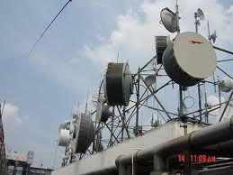
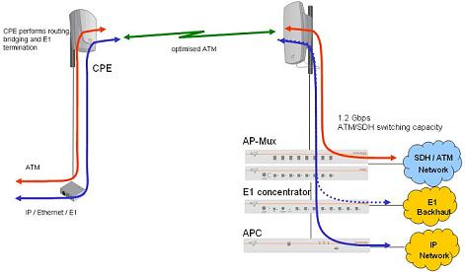
Microwave Department
Products
PTP Microwave Radios
  PDH
  SDH
  Long Haul SDH
  NMS
Nodal Solutions
Services
Planning & Design
Technical Consultancy
Site Survey
LOS & Link Budget (Design)
Installation & Commissioning
Integration
Dismantling
NMS & DCN Services
Operations & Maintenance

Slide 25
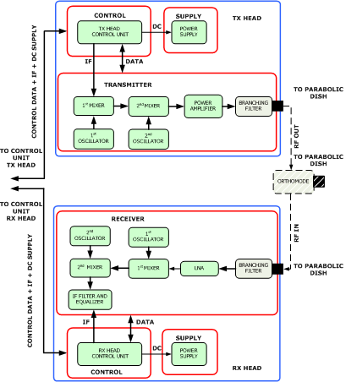
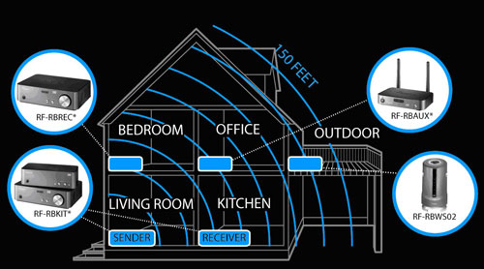
RF Indoor Department
Full Turn Key Solutions
  Design & Consultancy
  Walk Test
  Indoor Active Solutions
  Indoor Passive Solutions
  Antennas & Accessories
  Testing & Commissioning
Optimization

Slide 26

Operations & Maintenance Department
Wide Spread Existence throughout KSA
Head Office in Riyadh.
  Main Office in Medina, Al khobar
  Many Operational Offices ( Project Based).
24 x 7 x 365 Support
Managed Services (FLM & SLM)
  GSM/WiMax/Fixed
    RF, EM and CW
Supply of Spares
Repairs of Faulty Equipments

Slide 27

Clients (Partial List)

Slide 28












Partners & Products
Sunshine is tied up all the brands to serve our clients better and with more Varity of product and services so that we have 100% customer satisfaction.

Slide 29

Technology Partners
i-Assure Info Solutions Pvt. Ltd. is part of Brindhavan Group in India which has an annual revenue of over USD 100 Million
iAssure was Established in the year 2007 by Brindhavan to provide innovative IT products & Solutions to its customers
iAssure is proud to have an excellent customer base in India and ambitiously working to expand outside India
i-Assure’s international expansion includes Saudi Arabia, Other Gulf countries, USA, UK and Asia Pacific countries
iAssure works with the local partners in these countries to provide an excellent customer support

Slide 30

SunShine (Saudi LADA)
P.O. Box 18342
Riyadh 11415
Office No.12, 2nd Floor
Saudi Arabia
Tel: +966 1 4766330
Fax: +966 1 4773165
Mobile: +966 504 129134
+966 533 466993
waleed@SunShine-sacom
www.SaudiLada.com
www.iassure.in
Thank you

